Slide 1
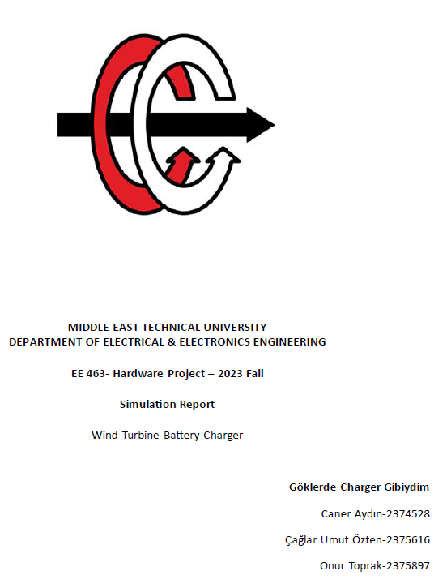

Slide 2
OUTLINE
Battery Illustration
Topology Selection
Simulations
PWM Generator
Component Selection
Bonus Parts

Slide 3
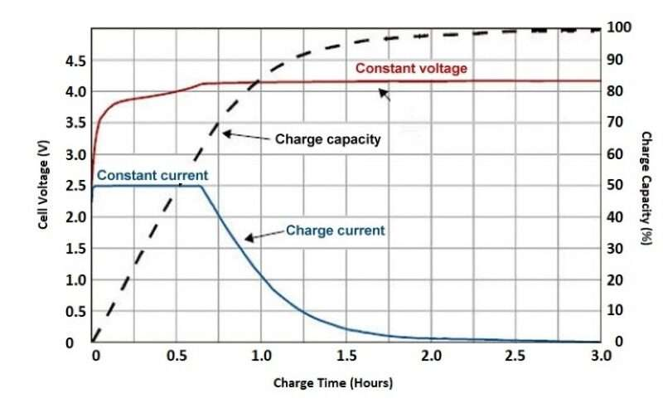
Charging types of battery

Slide 4
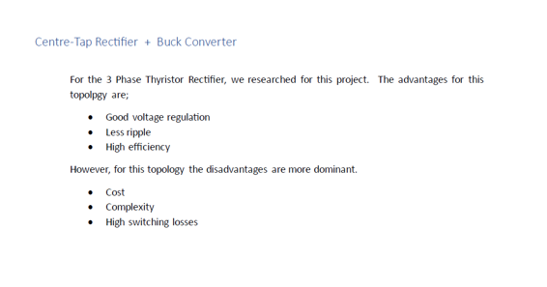

Slide 5
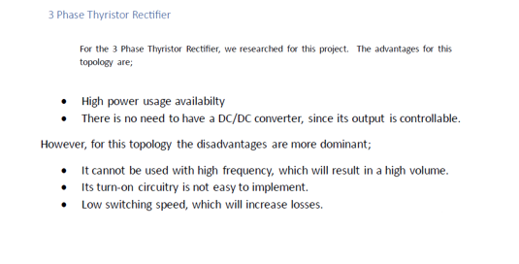

Slide 6
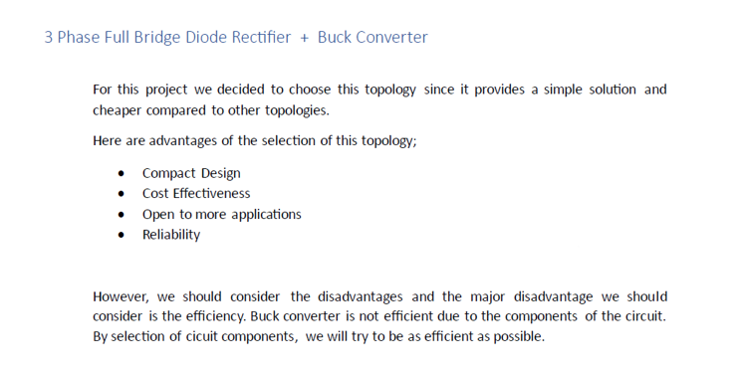

Slide 7
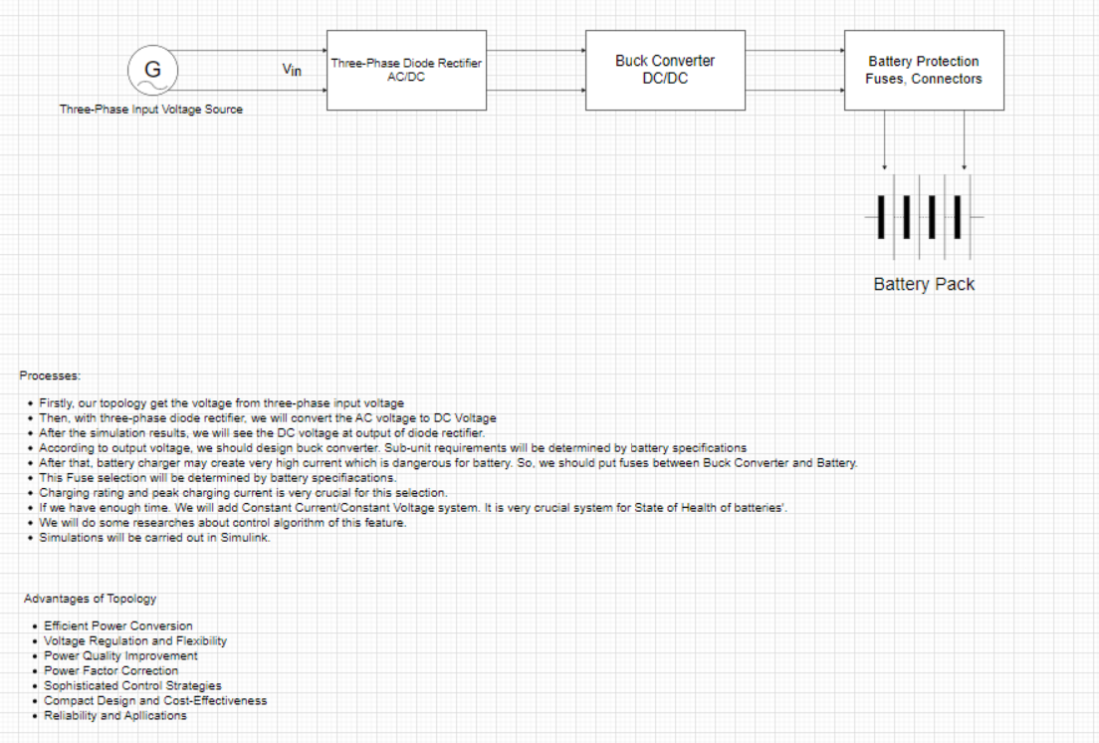

Slide 8
Overall Circuit Schematic for Battery Charger

Slide 9
Diode Current Waveforms (Maximum Input Voltage) and Diode Voltage Waveforms (Maximum Input Voltage)

Slide 10
Output Voltage Waveforms , Output Voltage Waveforms (Maximum Input Voltage)

Slide 11
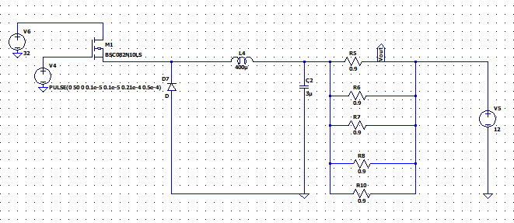
Buck converter circuit

Slide 12
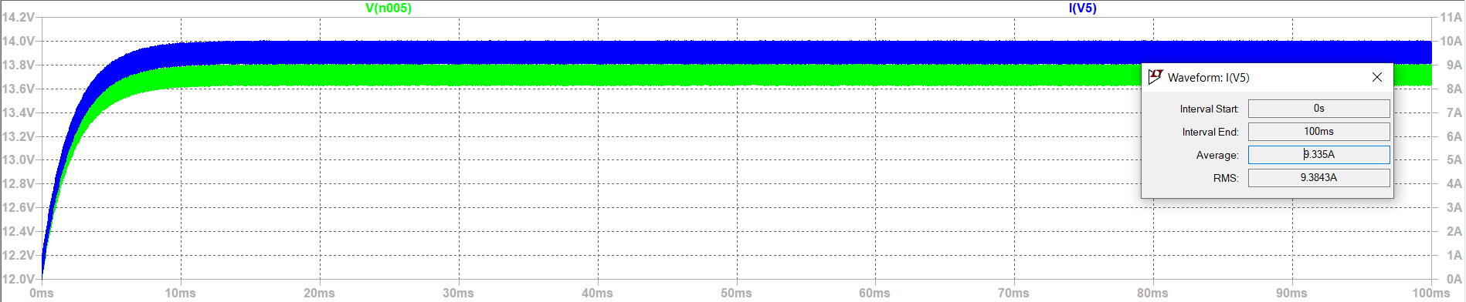
Output Voltage Waveform of Buck Converter

Slide 13
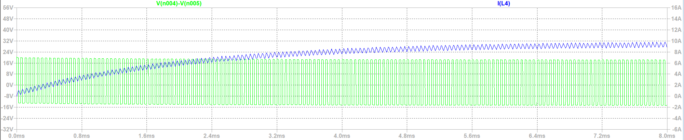
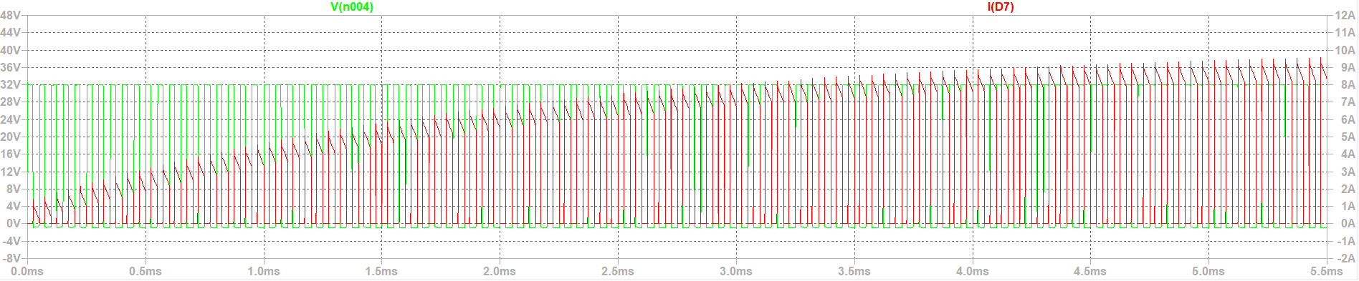
Buck Converter Voltage and Current Waveform of Inductor and Diode

Slide 14
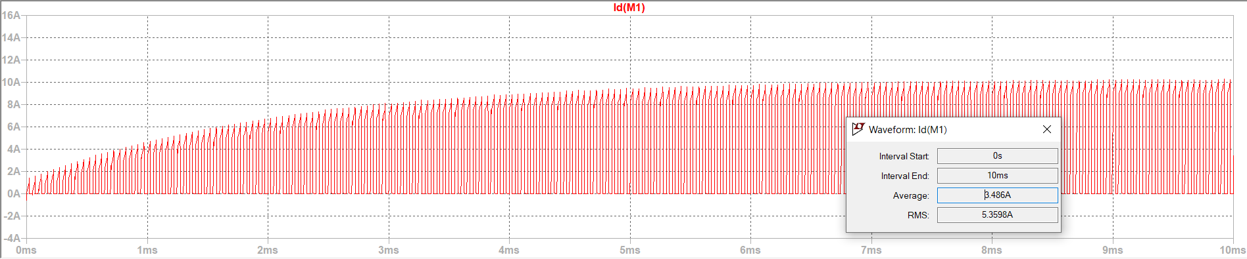
MOSFET Current Waveform (Id)

Slide 15
Gate Signal

Slide 16
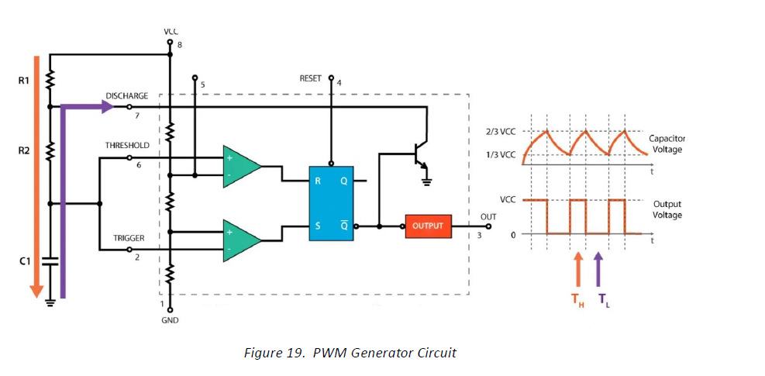
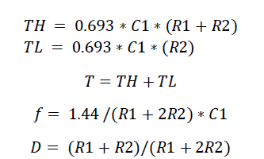
Timer Circuit LM555

Slide 17

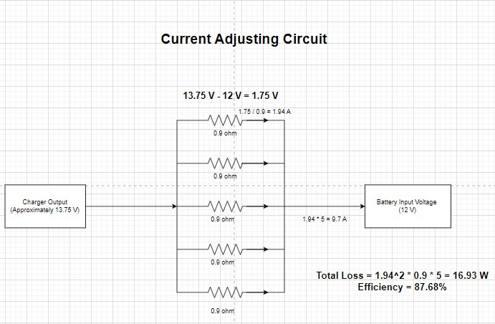
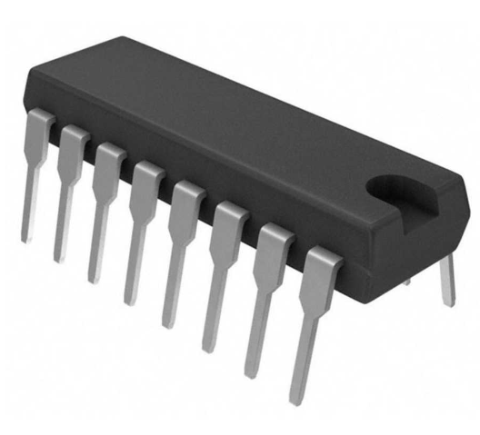
Controller Circuit
TL494 VOLTAGE REGULATOR
Integrated Controller Circuit
Feedback from battery to keep Id 10 A constant.
Voltage regulator at the end with resistor or a regulator

Slide 18
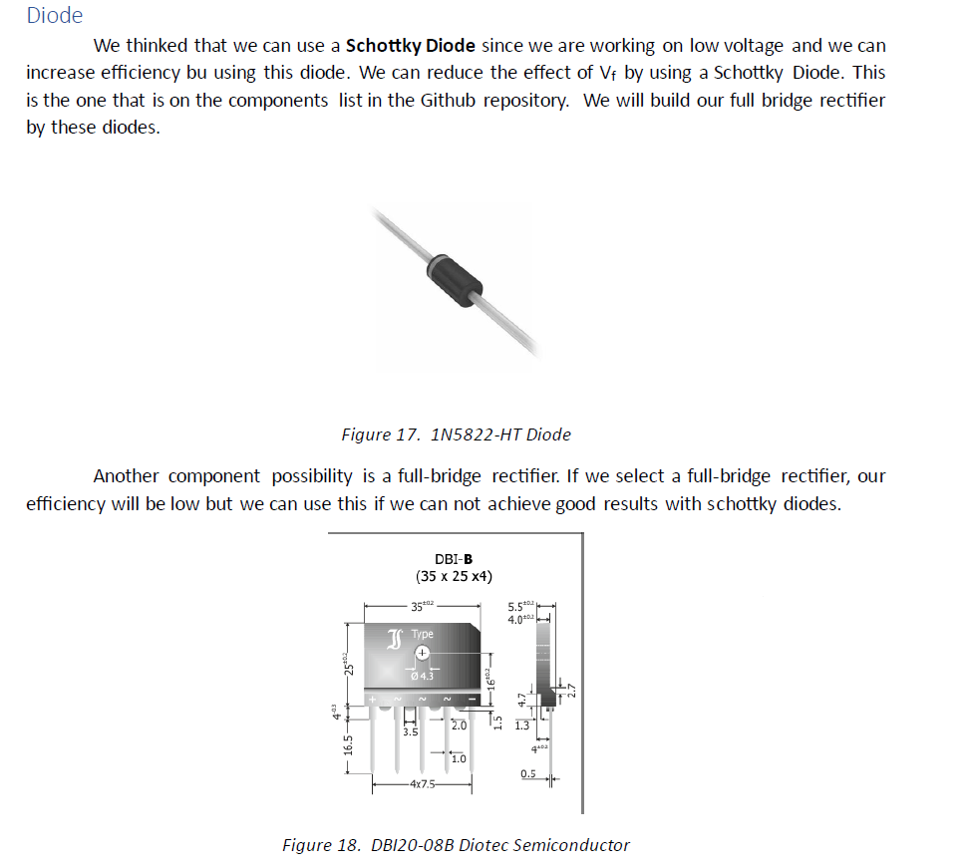
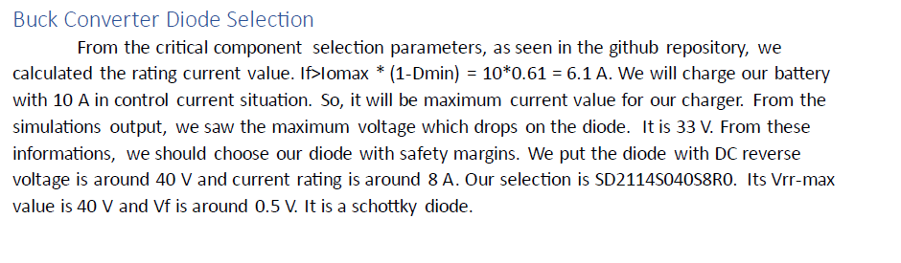
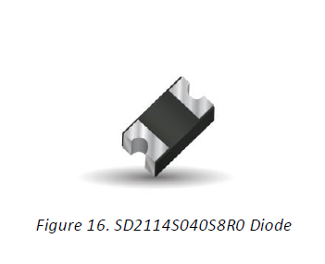
Component Selection
Diode

Slide 19
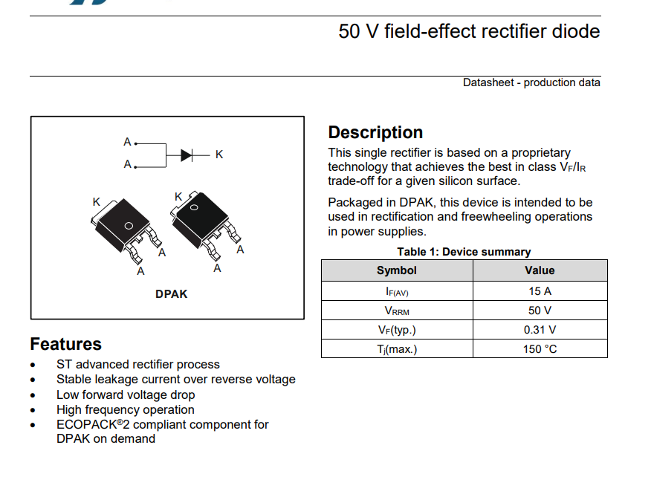
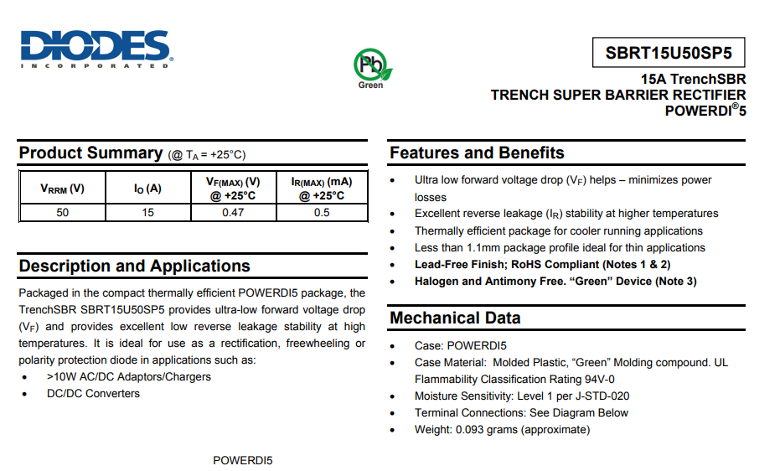
BUCK CONVERTER DIODE

Slide 20
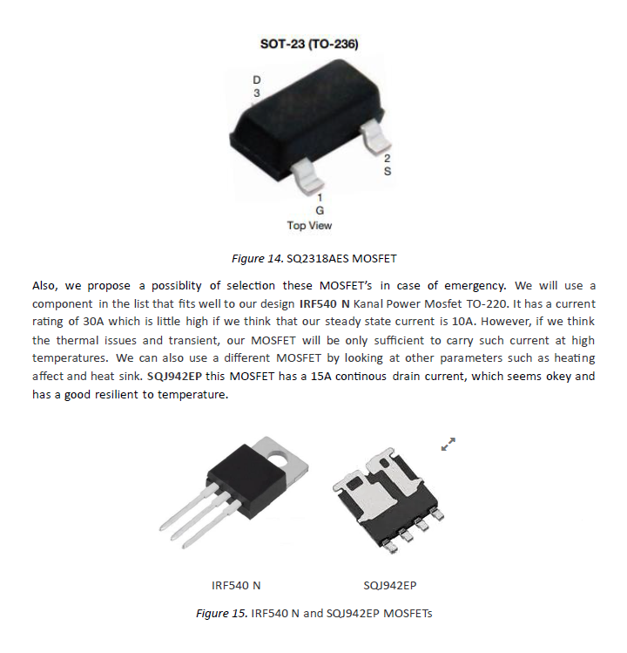
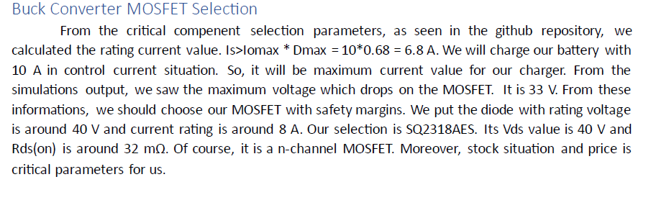
MOSFET
IRF 540 N Mosfet 100V 28A

Slide 21
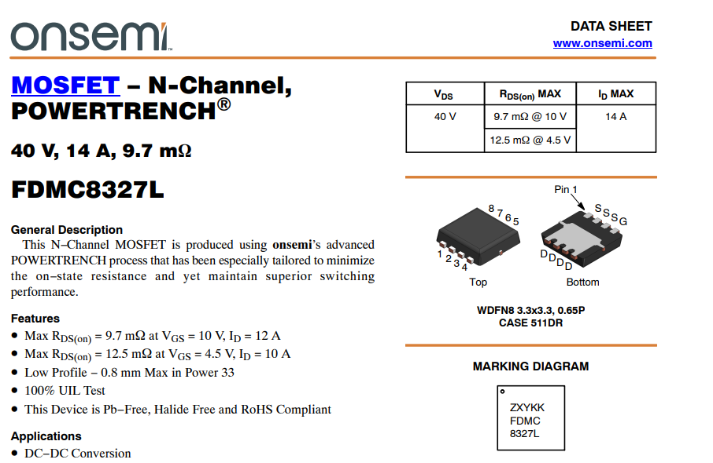
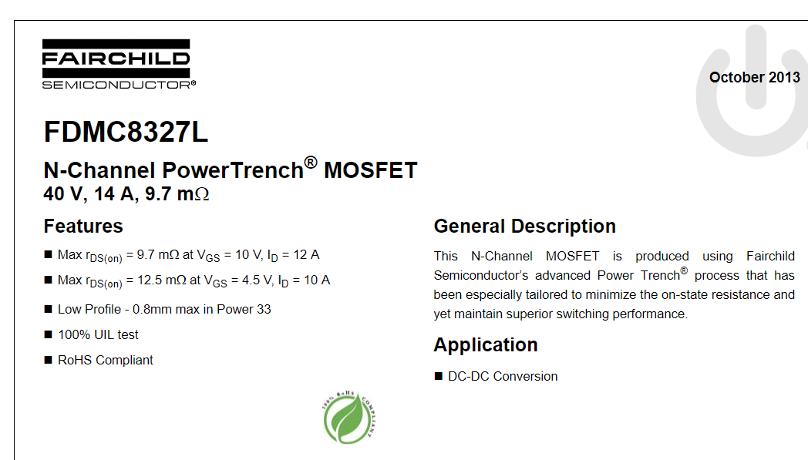
MOSFET

Slide 22
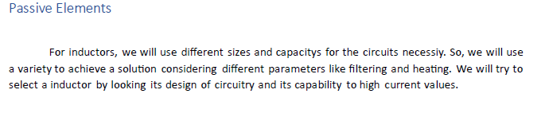
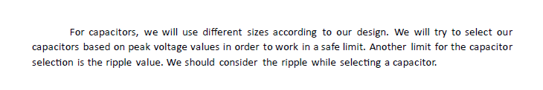

Slide 23
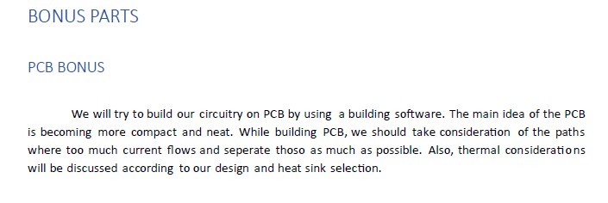
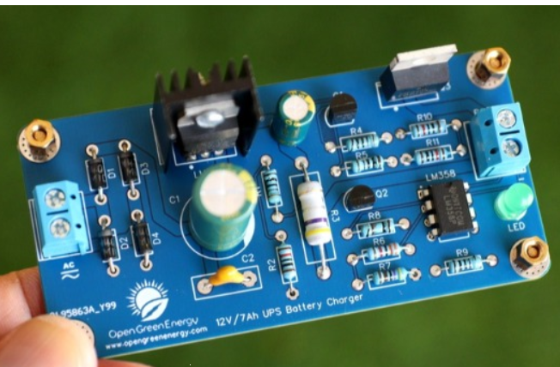
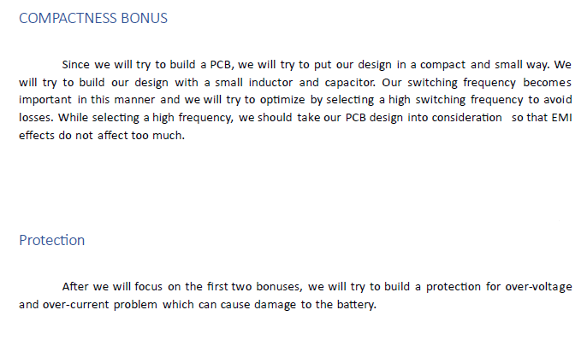
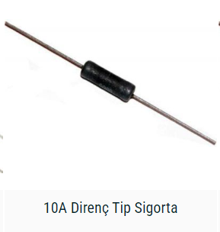
BONUS

